Slide 1

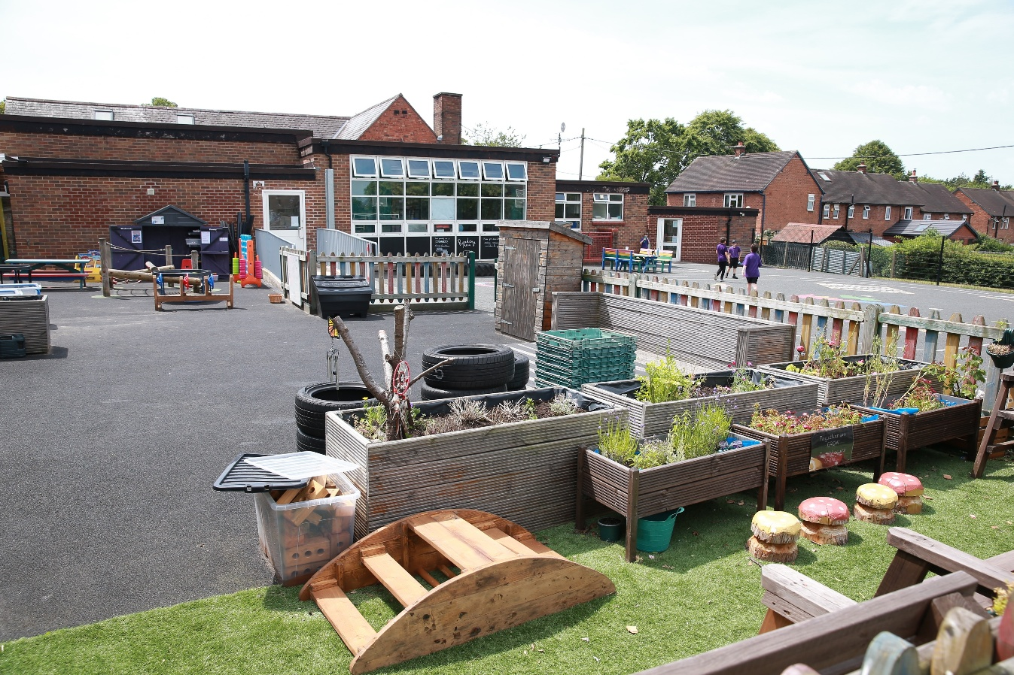
Clutton
C of E PRIMARY School
Meet the Teacher
Year 5/6
Miss Hough

Slide 2


Welcome to Oak Class at Clutton
We are unique in our local area because of our size, allowing us to offer numerous benefits for families to ensure their children flourish. Our children and families are known and valued within our tight-knit community, fostering a sense of belonging and support. With smaller class sizes, pupils receive personalised attention as individual needs are addressed effectively. Our pupils are confident, happy to play and work with children older and younger, giving them valuable communication skills and problem solving skills which benefit them as they move on to high school and beyond!
Since December 2025 we have been part of the CDAT academy trust which not only benefits our pupils but our staff development as well.
https://www.cdat.co.uk/main/home

Slide 3
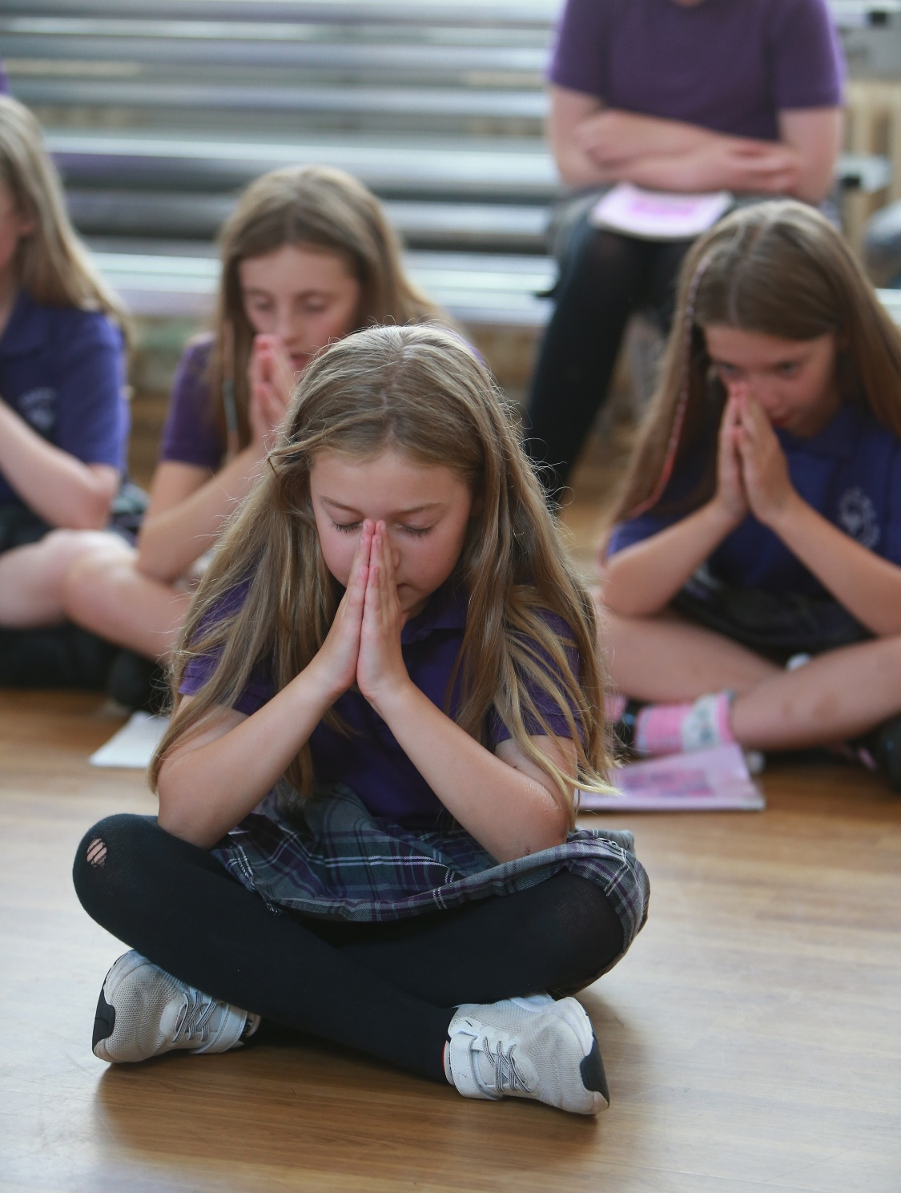
We strive to provide a primary education your child will never forget. Rich with diverse opportunities and experiences set within a
Christian context.
Together we grow, together we shine.
Matthew 13: 31 - 32

Slide 4

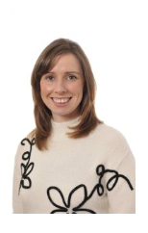
Meet our Senior Leadership Team
Mrs Nic Badger - Executive Headteacher
Miss Lucy James – Senior Teacher

Slide 5
Who will be working with your child this year….
Miss Phoebe Hough - Teacher
Mrs Christine Rose- Class Teaching Assistant

Slide 6
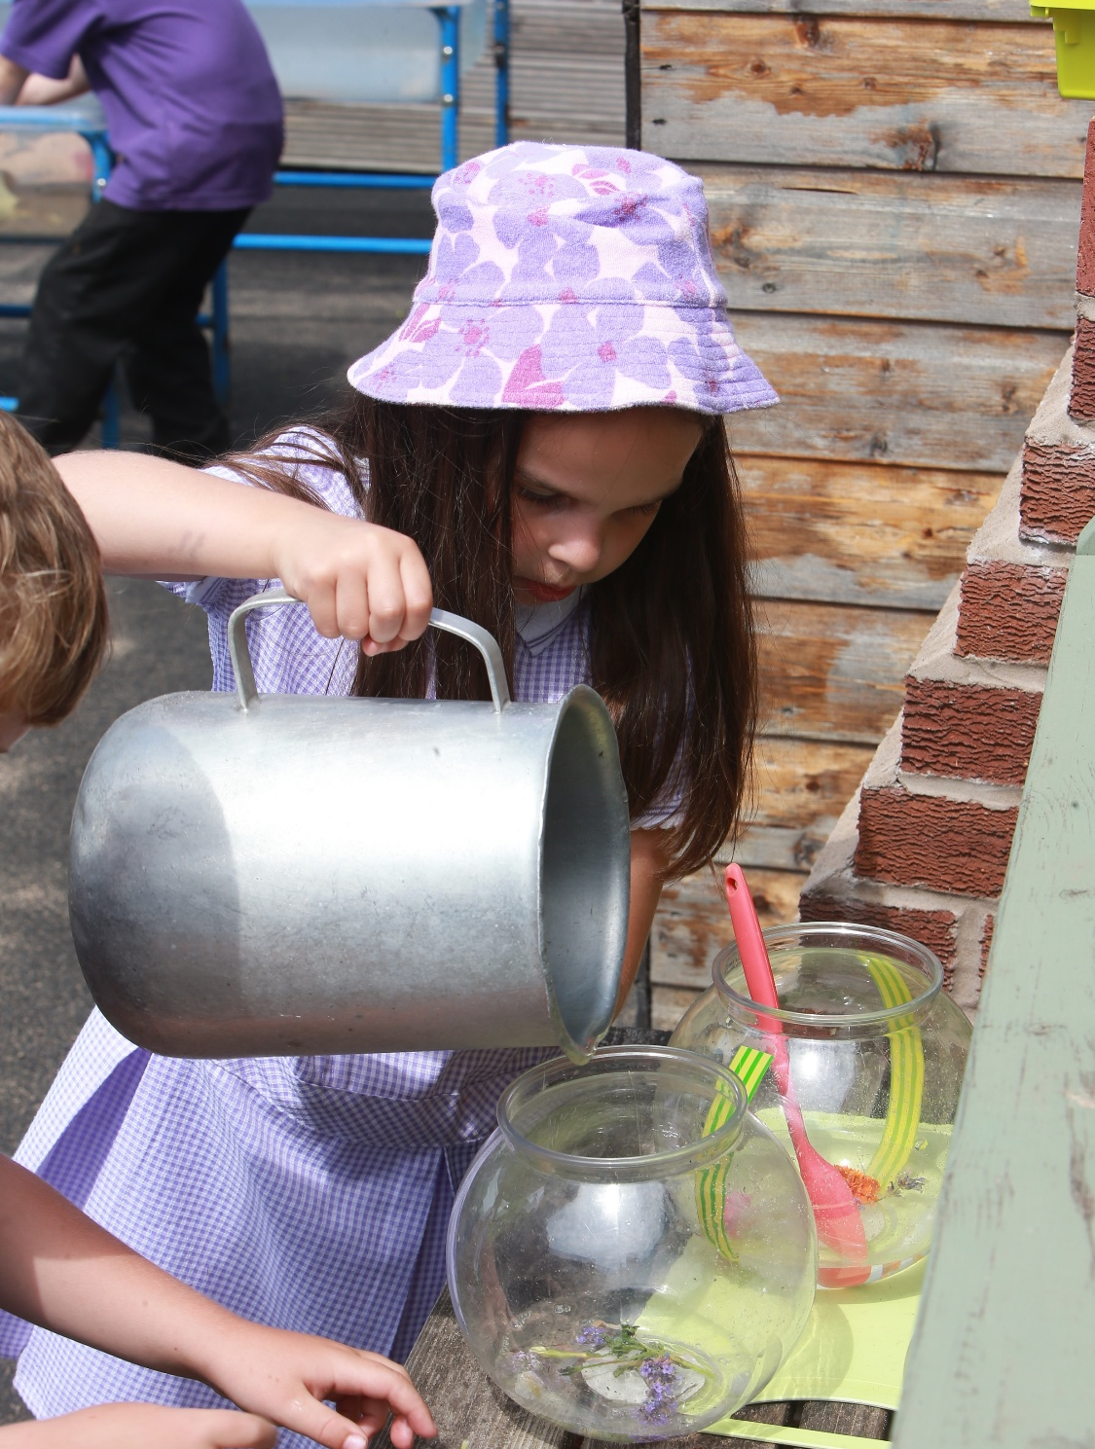
Our Christian values underpin all we do:
Our children are happy, caring and empathetic to others
Our children learn and develop as moral individuals within the context of Christian values
Together we grow, together we shine.
Matthew 13: 31 - 32

Slide 7
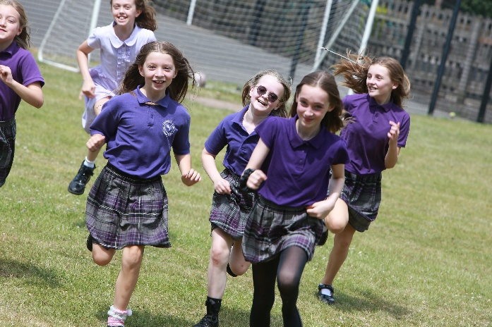

Our School rules
Together we grow, together we shine.
Matthew 13: 31 - 32

Slide 8
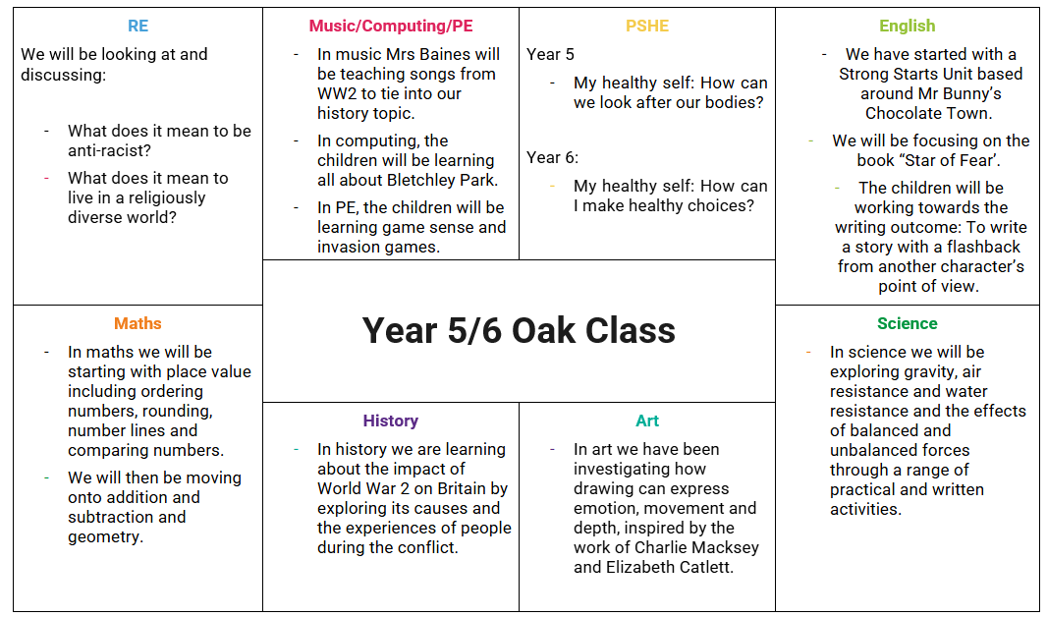
Autumn term learning 2026

Slide 9
HOMEWORK
Each child will receive a reading diary and homework journal in order to complete homework tasks.
Reading – reading between 4 – 7 times a week is given a high priority from reception to year 6. Reading entries will be recorded in a reading diary which all the children will be provided with. Each half term, class teachers will also issue a list of recommended reading both fiction and non-fiction linked to the connected curriculum theme.
Spelling – Children will receive a spelling list of age appropriate high frequency words at the start of each week to learn. The children will be learning between 8-10 words each week. This will be in addition to spelling patterns from staged spelling groups where words are tested weekly. Children in KS2 will receive these on a Monday and be tested the following Monday.
Times tables – Children will receive specific times tables to learn in each year group. Year 5 and 6 children are expected to learn all times tables with related division facts.
Maths- Children will receive a weekly maths homework sheet that related to what we have been working on that week. These will go out on a Monday and will be returned the following Monday.
Home learning projects – As part of our inclusive curriculum, all classes will be asked to complete a home learning project once a half term. These projects, Take away homework, are linked to the class learning theme and children have a choice of which task they wish to complete at home. We believe that these projects are a great opportunity for parents/carers to work alongside their child, enhancing their learning experience. The projects are shared and celebrated with other classes.
Knowledge organiser – Key facts, information and vocabulary linked to the area of learning in class for that term. Children will be expected to know some of the facts and use these key words within their learning.
Year 6 – There may be times in year 6 when further homework will be set to extend and reinforce the learning in the classroom.
Together we grow, together we shine.
Matthew 13: 31 - 32

Slide 10
Statutory Testing
Statutory testing takes places in Year 1 – Phonics screening, Year 4 – Multiplication Test and at the end of Key Stage 2
Key Statutory Assessments
Key Stage 2 SATs: Taken in May of Year 6 in English reading, mathematics, and grammar, punctuation and spelling (GPS). Writing is assessed by teachers at the end of every unit.

Slide 11
High Schools
Secondary School Applications – Key Dates
September 2027 entry (General)
September 2026: Applications open
September 30th: Bishop Heber Open Evening
31 October 2026: Application deadline
1 March 2027: National Offer Day
March–April 2027: Appeals (if required)
Remember: Apply through your home local authority and check their website for specific guidance and deadlines.
GOV.UK – Apply for a secondary school place
Together we grow, together we shine.
Matthew 13: 31 - 32

Slide 12
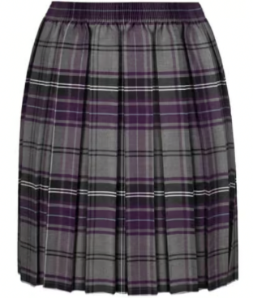
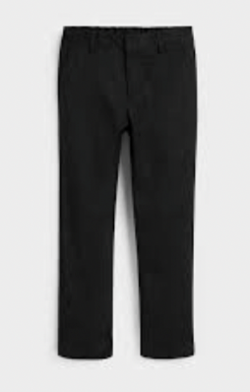
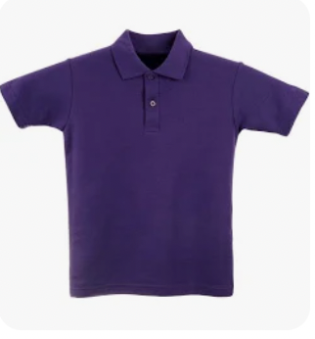
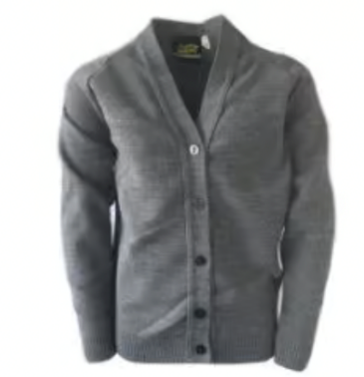
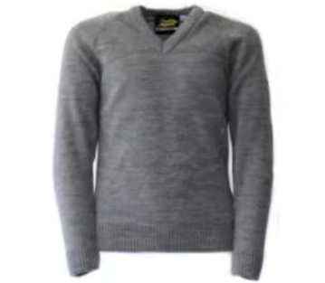
Uniform
At Clutton C of E Primary School we are proud to have a smart and distinctive school uniform. You can purchase school embroidered items including the polo top, cardigan/sweatshirt/jumper, crew neck PE t shirt, and the tartan skirt from Brigade Direct.
PE and book bags are also available to order through Brigade, please select the Quandra book bag for children in reception, year 1 and year 2.
Uniform:
- Tartan skirt or long black trousers
- Purple polo shirt
- Grey V-neck sweatshirt/jumper/cardigan
- Black tights or socks and black shoes.
In line with national policy our 3 branded items are:
Summer: Purple gingham summer dress with white socks and black shoes, or purple polo shirt with black shorts and grey V-neck jumper, black socks and black shoes. This can be worn from Easter to October half term.
or
or

Slide 13
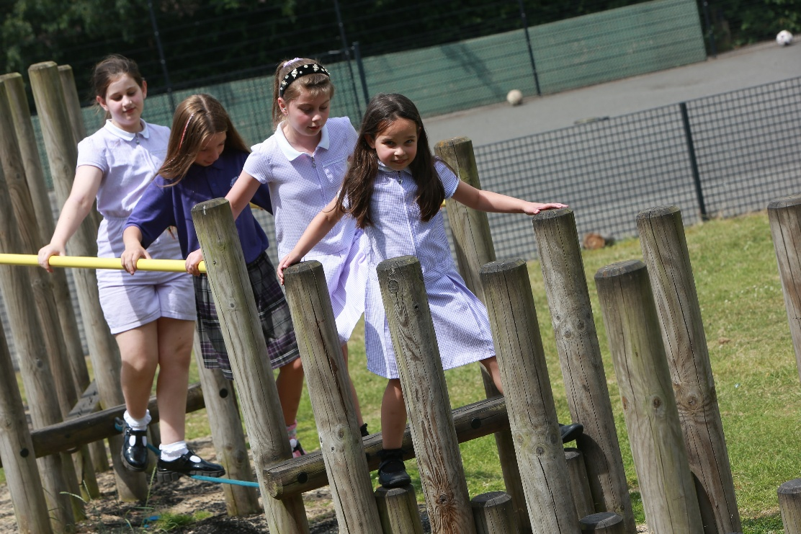
PE KITS
Children need to come to school in their PE kit on PE days
PE for Oak class is on the following days: Monday and Wednesday.
PE kit should be named.
NO FOOTBALL TOPS or STRIPS please.
PE kit: Purple crew neck t-shirt with black shorts, black socks and black pumps (indoor PE). Black tracksuit/jogging suit for winter.

Slide 14
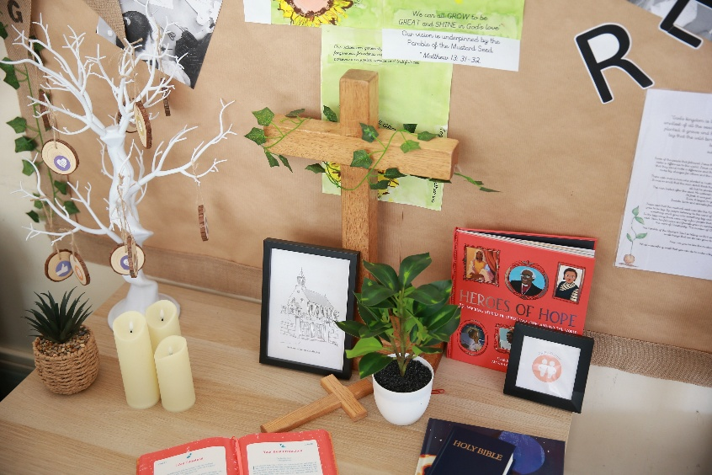
SCHOOL COMMUNICATION
If there is anything you would like to talk to us about, no matter how small it may seem, please do!
Unless I have a club or other commitment straight after school, I will be on the playground each day at 3.15pm, or please make an appointment through the school office. Unfortunately, I cannot speak at length with anyone in the morning unless it is an emergency as I am needed in the classroom with the children.
You can email the office on: admin@clutton.cheshire.sch.uk
Or contact Mrs Badger: principal@clutton.cheshire.sch.uk

Slide 15
Thank you for your support and I look forward to seeing you through the school year.

